Slide 1

SOA and
Regulatory Compliance
Bringing together IT and
Business Goals
Dr. Said Tabet
Co-Chair, OMG Regulatory Compliance
Co-Founder and Co-Chair, The RuleML Initiative
President and CEO, INFERWARE CORP.
Email: stabet @ inferware . com; stabet @ ruleml . org
Notes:
Thank you very much to Jim and Harsh for the invitation and thank you all for joining us here today. It is a pleasure to be here today. SOA is playing an increasingly important roles with corporations worldwide and affecting all aspects of the enterprise. I want to give you an overview on our activities in the Regulatory Compliance SIG and ORCA. Compliance is probably one of the very few factors that can make or break SOA and I will tell you why…

Slide 2
Agenda
Introduction
Scope of compliance:
  Global IT and IT Compliance Problems
Regulatory Compliance and Information Technology
OMG Regulatory Compliance Activities
  RC DSIG: Regulatory Compliance standardization at OMG
  ORCA: OMG Regulatory Compliance Alliance
  CGRID: OMG Regulatory Compliance Database
Automated IT Compliance
SOA and the Compliance factor
Conclusions and Discussions

Slide 3
IT Challenges and Priorities
Manage risk
Manage internal controls
Manage data (Records Management)
Facilitate financial reporting
Ensure business continuity
    Provide services that give
    a competitive edge

Slide 4
Compliance as a Business Problem
Reacting to regulations - rather than anticipating their requirements - often leads to redundant IT efforts
    Implemented in silos and in systems that are not interoperable
    High cost of operation and low efficiency
    High risk of missed requirements
    Low probability of sufficient evidence capture or generation capabilities
Notes:
The problem is complex and impacts both the functional and technical aspects of the company’s business processes. Requirements to comply with regulations and internal policy are not understood in a normalized way, creating a high degree of redundancy. The question is to figure out how to minimize the redundancies and deal with the requirements efficiently.

Slide 5
Global IT Compliance Problems
Regulatory compliance costs IT departments $billions
  The US alone passes over 4,000 new final rules annually – dozens have significant IT impact.
  Sarbanes-Oxley (SOX) impacts all US public firms (over 15,000) at a typical cost to IT of $.5-1M annually
  Basel II will cost over $15B globally
  Different jurisdictions have conflicting rules
    e.g. privacy – US and Europe, different fundamental assumptions
New regulations lead to uncertainty
  Ambiguous requirements are inherently risky
  Best practices change over time, hard to keep up
Notes:
Let’s start by developing an understanding of the scope of this problem from the IT perspective.
It is big, it is ugly, and it isn’t getting better. We’ll see that there are a few major categories of regulations, but the biggest concern for global firms is identifying which regulations apply in a particular situation, what level of activities are necessary to ensure compliance, and what to do when overlapping rules demand conflicting actions. For example, in some areas customer data must be retained, in others it may not be retained!
Let’s look at a few of the key regulations concerning IT management today.
>>>>>

Slide 6
A Regulatory Sampler
Sarbanes Oxley Act of 2002
Uniting and Strengthening America by Providing Appropriate Tools to Intercept and Obstruct Terrorism Act (USA Patriot Act)
Personal Information Protection and Electronic Documents Act (PIPEDA)
Basel II – The New Capital Accord
Gramm-Leach Bliley Act (GLBA)
SEC Rules 17a-3 and 17a-4
Health Insurance Portability and Accountability Act (HIPAA)
21 CFR Part 11
US Senate Bill 1350, AKA Notification of Risk to Personal Data Act
California Senate Bill 1386 (SB 1386)
Notes:
I’d like to point out here is that within a vertical market, or within a regulatory category like privacy, we often see overlaps and conflicts. We used to speak of regulated and unregulated industries, but the reality today is that no business escapes the cost of regulations. >>>>
Many vertical markets have specialized regulations, but today we’ll focus on the major categories that cut across markets to govern most businesses
Governance regulations attempt to control the processes within an organization, usually to improve the transparency of their workings to improve the confidence of investors, or to ensure that entire industries cannot be shut down in the face of external threats. For example, the SEC, the Federal Reserve Board, and the Office of the Comptroller of the Currency jointly issued a set of requirements for financial services firms in the aftermath of the September 11th attacks. The goal was to provide minimum standards for disaster recovery and business continuity in the event of natural disaster or terrorist attack.
Privacy regulations are typically enacted to protect individuals from damages caused by casual release of their personal information, including identity theft.
Security regulations are generally enacted to ensure the resilience of systems in critical businesses, or in conjunction with privacy concerns.
Trade and tariff regulations are generally handled by general management, but IT must be aware of governing rules that could be detected by their systems (may a rule based list of countries to prevent shipping products to embargoed nations, for example)
Environmental regulations with an IT impact take two forms – those that can be detected by IT (such as shipping hazardous materials), and those that restrict the disposal of IT equipment and its hazardous materials.
SOX – this is the big one, with the biggest price tag and impact, so we will cover it in greater detail in a moment
USA Patriot Act – the most sweeping and controversial security legislation of our time, it affects businesses from financial services, which need to track suspicious money flows to identify terrorist activities and money laundering, to libraries, which must surrender patron preferences and behaviors if they are captured by information systems. Major provisions of this one are subject to review.
NORPDA, and the California Senate Bill that inspired it, require businesses to report to consumers when their private data may have been compromised. A recent example was seen last month when a GMAC employee had 2 laptops containing 200,000 customer records stolen from his car, and the firm had to notify all California residents of the security breach.
PIPEDA – the Canadian rules which govern the use of personal information by businesses. It’s similar to recent legislation in the EU.
SEC rules 17a3/4 governs the retention of electronic correspondence in the securities industry.
Basel II provides an updated approach to the governance of risk in financial institutions. Firms with the best governance documentation and risk profile will be rewarded with the lowest rate for capital reserves. We’ve spoken with international banks that are already spending millions on IT solutions for Basel II, which goes into effect in 2006.
GLBA, or the Financial Services Modernization Act, made it possible for banks, brokerages, and insurance firms to combine and enter each other’s markets. It also put big constraints on their operations, and on the way customer data is handled.
21 CFR Part 11 (part of the Code of Federal Regulations), governs the use of IT in the health sciences markets, particularly within pharmaceutical firms. We have written about all these regulations in our newsletter and on our website.
The OMG tracks hundreds of regulations in dozens of geographical jurisdictions

Slide 7
(Mis)Information & Lack of Standards
IT activities are required for most major regulations, yet
IT often hears about the requirements as an afterthought
Example (2003)
  Over 80% of CFOs thought SOX would have little or no impact on IT budgets
  100% of CIOs said SOX would have a significant impact on IT (budgets)
No IT-oriented approach to the codification of best practices or development of IT compliance standards
Where are IT managers getting their information?
Why is it often wrong, irrelevant, or outdated?

Slide 8
The Communications Gap
Legislators
Operations
IT
Finance
Enforcers
Legal

Slide 9
Too Many Voices
Regulated
Entity
Legislators
Associations
Standards
Regulated
Entity
Enforcers
Regulated
Entity
Notes:
Why collaborate?

Slide 10
Overlapping Intents & Requirements
Privacy
Security
EU Data Protection Directive
Personal Data Protection
Act 25,326 – Argentina
Hong Kong Personal
Data Ordinance
UK Data Protection Act
PIPEDA
NORPDA
CA SB 1386
USA PATRIOT
DITSCAP DODI 8500.2
FISMA
Electronic Signatures
In Global & National
Commerce Act
GLBA
HIPAA
Protecting
Private Information
21 CFR Part 11
Protecting
Critical Data/Infrastructure
Sarbanes-Oxley
UK Companies Bill
Basel-II
SEC Rules 17a-3/4
OMB A-123
FISCAM
Ensuring
Transparency & Validity
Governance

Slide 11
Emerging Best Practices
Integration
  Factor regulatory requirements
    Privacy, Security, Governance (process monitoring)…
to benefit from common
        data model/user view
        process management
        access/retention model
        risk management approach
Collaboration
  Standards development
  Identify common compliance components
  Share components

Slide 12
Major Categories of Regulations
Governance
  Transparency and validation of financial reporting
  Records retention
  Disaster recovery/business continuity
Privacy/Disclosure
Security
Trade/Tariff
Environmental

Slide 13
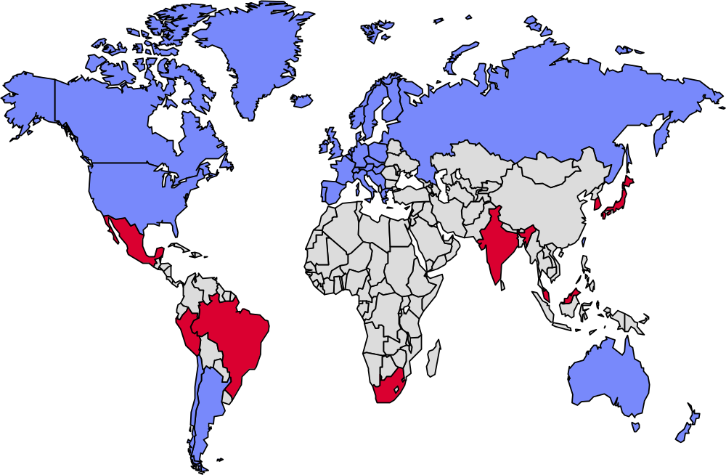

Global snapshot on privacy laws
Blue--Existing Private Sector Privacy Laws
Red---Emerging privacy
Sector Privacy Laws

Slide 14
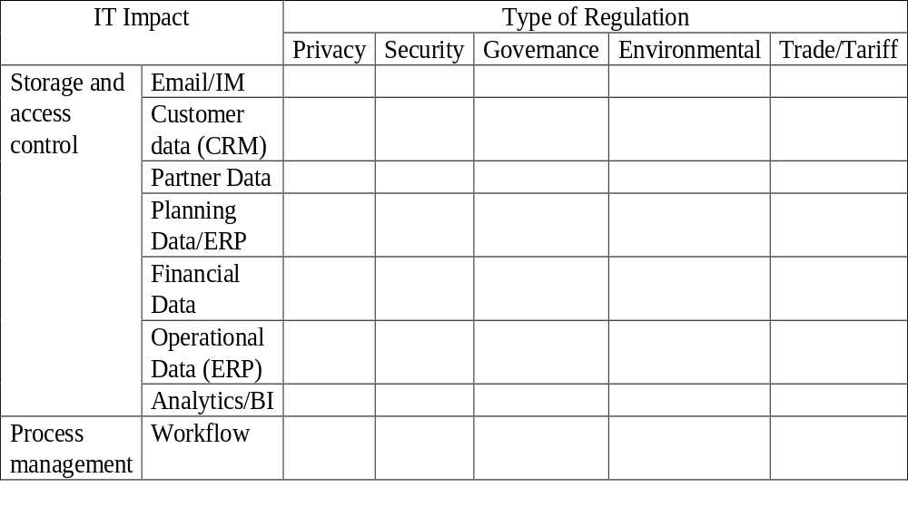
IT Impact by Category

Slide 15
The OMG and GRC:
Governance, Risk Management & Compliance
OMG Members - mostly global firms - were struggling with regulatory compliance costs and complexities
OMG reviewed available resources, and determined that a lack of standards for modeling regulations was hindering development of better tools to automate common compliance tasks
The OMG Board approved initiatives to address these issues for its members (April 2005)
Notes:
One question I often hear goes something like this: “I know that the OMG has developed great specs for interoperability and modeling, like CORBA and UML, but why are you branching out into the governance, risk management, and compliance (or GRC) space? Isn’t that a stretch for OMG?”
Actually, it isn’t. The mission of OMG is to produce and maintain computer industry specifications for interoperable enterprise applications, and one of the biggest issues for our members today is enterprise GRC. Over the past few years, OMG members have expressed an interest in applying the same rigor we apply to the development of other specs to solve problems in the GRC space. As we see in the industry at large, GRC costs were increasing for our members, and there was no single resource aimed at IT-oriented solutions. Our research determined that a lack of standards for representing GRC information was hindering the development of tools to capture important data and metadata that could lead to some degree of automation. With that in mind, a proposal for two initiatives to address these issues was approved by the OMG Board in April of 2005. We’ll look at the specifics of those initiatives after a brief review of the current state of GRC-induced stress as it affects global IT.

Slide 16
OMG’s GRC Activities
RC-SIG
  Established 4/2005
  Following the OMG process to develop modeling standards to represent regulations, facilitating automation of compliance tasks
  Met throughout 2005 to identify key requirements for RC modeling
  Currently preparing RFPs
OMG Regulatory Compliance Alliance - ORCA
  Research & Education Events
C-GRID : Global Regulatory Information Database
Notes:
As I mentioned, OMG launched two GRC initiatives in 2005. The first is the Regulatory Compliance Special Interest Group. The RC-SIG has met regularly since then to develop modeling standards to represent regulations, guidance documents, control frameworks, and other related documents in a standard format. The goal is to facilitate the classification, capture, comparison, and use of these documents which will enable the development of interoperable tools for their analysis. The RC-SIG is currently preparing RFPs for general circulation, but the metadata models are already in use by member organizations. This work was supported by over a dozen OMG member firms, and co-chaired by Said Tabet and John Hall.
The other major effort was the establishment of a working group called ORCA - the OMG Regulatory Compliance Alliance. ORCA has held several public meetings to gather and disseminate best practices for GRC, and is currently focused on the development of the compliance GRID, or Global Regulatory Information Databse. The C-GRID is an open database project that will provide a platform for new tools and services to be provided by ORCA and OMG member firms.

Slide 17
Goals and Objectives
Improve the ability of enterprises to:
  Effectively comply and demonstrate compliance with relevant regulations
  Reduce the time, and initial and on-going costs of complying with regulations
Improve the ability of vendors of IT based products and services to develop offerings that:
  comply with regulations, or that
  enable the planning, implementation and control of processes and rules to comply with regulations

Slide 18
Goals and Objectives (Cont’d)
Improve the ability of regulators to formulate regulations that capitalize on best practices and standards for complying with regulations
Improve the ability of auditors and other service providers to assist enterprises to ensure regulatory compliance by applying best practices and standards

Slide 19
OMG Regulatory Compliance Alliance
Research and represent the needs of IT to regulators
Classify, codify, and publish best practices and standards by Regulation across Industry and Geography
Develop and maintain a comprehensive repository of global regulations and their impact on IT, searchable by Industry and Geography

Slide 20
Global Regulatory Information Database
ORCA’s Global Regulatory Information Database (Compliance GRID) is an open database of rules, regulations, standards, and government guidance artifacts and documents. The goal is to provide the de facto compliance reference guide for global (IT) compliance managers.
The C-GRID was designed to enable users to determine:
  Which regulations apply to a particular firm?
  What are the best practices for compliance with these rules?
  What is the impact of mergers/acquisitions that involve new
  markets or operational geographies?
  Who can help them with associated products and services?
Notes:
The C-GRID project is designed to be an open resource for OMG members and the general public. Our research found that there was no single resource that captured the essential GRC data in a form that would allow simple queries for firms attempting to understand which rules applied to them, based on their vertical market, geographic markets served, and attributes such as public or private ownership. Given the rapidly changing regulatory landscape, and the additional pressures imposed by merger and acquisition activities, such a gap was proving to be costly for OMG members.
As a starting point, we built a robust distributed architecture based on a flexible model for representing global rules, regulations, standards, guidance documents, frameworks, and internal controls. The first version of that software is complete, and we have started to populate it with links to these documents and metadata regarding their structure and usage.

Slide 21
C-GRID Geographic Scope
The first release of the C-GRID is focused on the banking vertical, and includes rules from the following countries:
Argentina Hong Kong Singapore
Australia India South Korea
Belgium Italy Spain
Brazil Japan Sweden
Canada Luxembourg Switzerland
China Mexico United Kingdom
France Netherlands USA
Germany Portugal
and multi-national entities such as the European Union (EU)
Notes:
We are focused at this point on rules in the global banking space, particularly in North America, Europe, and key Asian markets. This includes specific vertical market rules that only apply to banking enterprises, but also horizontal rules, such as privacy and security regulations, that happen to cover banking in their broad mandates. As an open project, we opportunistically accept IP contributions outside this scope, such as the privacy rules for approximately 100 countries that were contributed by individuals and firms who were already tracking this information. The scope is a simple indicator of the areas where we will actively solicit and develop our own IP in response to perceived market needs.

Slide 22
Types of Rules to be Captured
Outsourcing Regulations / Principles / Guidelines
IT Governance and Operational Risk (incl. IT risk) Management
Data Privacy & Transfer
Spam
Data Retention & Secrecy
Security & Safety of IT Systems and Infrastructure
Business Resiliency (incl. BCP/DRP)
Electronic Surveillance & Monitoring
Electronic Transactions & Digital Signatures
Networks & Firewall Policies.
Notes:
We are focused at this point on rules in the global banking space, particularly in North America, Europe, and key Asian markets. This includes specific vertical market rules that only apply to banking enterprises, but also horizontal rules, such as privacy and security regulations, that happen to cover banking in their broad mandates. As an open project, we opportunistically accept IP contributions outside this scope, such as the privacy rules for approximately 100 countries that were contributed by individuals and firms who were already tracking this information. The scope is a simple indicator of the areas where we will actively solicit and develop our own IP in response to perceived market needs.

Slide 23
A Roadmap to Address the Problem
Capture and Catalog the Requirements
  The C-GRID captures the fine-grained structure of the following types of compliance documents:
      Laws
      Regulations
      Guidelines
      Executive Orders
  And makes them available in a standard format to facilitate evaluation
Notes:
Our first step was to build the system to capture regulatory information at a fine level of granularity. We think of this first release as a catalog, as our initial design called for a system that would allow us to collect information on these compliance documents, with links to the original sources, and facilitate contributed input and easy searches. Let’s look first at the level of detail we can capture.

Slide 24
Fine-Grained Structure and Vocabulary
Paragraphs are connected to one or more vocabularies and map to their terms and definitions
Example:
An electronic signature belonging to another person may be used only if two or more persons in the organization collaborate.
Compliance Document
Compliance Vocabulary
Terms
Compliance Document Part
Compliance Document Sub-Part
Compliance Document Paragraph
Compliance Document Paragraph
Organization
Person
Electronic Signature
Notes:
In addition to the rich metadata provided in the C-GRID information model, each compliance document, be it a law, a regulation, a guideline, etc, is organized using a fine-grained structure, similar to the US Code Of Federal Regulations approach. A compliance document is made of document parts, themselves organized into sub-parts, where each sub-part may have one or more paragraphs. Paragraphs can be then normalized and standardized as conditional statements. OMG has a number of efforts in the area of business rules. The example shown above is from 21CFR11 regulation. Terms from each paragraphs can be linked to one or more vocabularies, providing access to various glossaries (the C-GRID has over currently 5,000 terms).

Slide 25
Catalogs are the First Step
Regulations Framework Objectives Internal Controls
HIPAA
Anti-virus software
is up to date
164.308(a)(6)(ii) Identify and respond to suspected or known security incidents; mitigate, to the extent practicable, harmful effects of security incidents that are known to the covered entity; and document security incidents and their outcomes.
CobIT
DS 5.7 Security Surveillance IT security administration should ensure that security activity is logged and any indication of imminent security violation is reported immediately to all who may be concerned, internally and externally, and is acted upon in a timely manner.
Anti-virus software
is running
164.310(d)(i) Disposal Implement policies and procedures to address the final disposition of electronic protected health information, and/or the hardware or electronic media on which it is stored.
Anti-virus software
is installed
164.308(a)(5)(ii)(ii)(b) Protection from malicious software [In deciding which security measures to use, a covered entity must take into account the following factors:] Procedures for guarding against, detecting, and reporting malicious software.
DS 11.20 Retention Periods and Storage Terms Retention periods and storage terms should be defined for documents, data, programs and reports and messages (incoming and outgoing) …
Networks are monitored
for security threats
Business records
are archived.
SOX
DS5.19 Malicious Software Prevention, Detection and Correction Regarding malicious software, such as computer viruses or Trojan horses, management should establish a framework of adequate preventative, detective and corrective control measures, and occurrence response and reporting.
404(a)(2) [The Commission shall prescribe rules requiring each annual report…to contain an internal control report, which shall]…contain an assessment, as of the end of the most recent fiscal year of the issuer,
of the effectiveness of the internal control structure and procedures of the issuer for financial reporting.
Security events are logged
Records are destoyed in
accordance with the
retention policy.

Slide 26
Mappings Must be Automated
Regulations Framework Objectives Internal Controls
HIPAA
Anti-virus software
is up to date
164.308(a)(6)(ii) Identify and respond to suspected or known security incidents; mitigate, to the extent practicable, harmful effects of security incidents that are known to the covered entity; and document security incidents and their outcomes.
CobIT
DS 5.7 Security Surveillance IT security administration should ensure that security activity is logged and any indication of imminent security violation is reported immediately to all who may be concerned, internally and externally, and is acted upon in a timely manner.
Anti-virus software
is running
164.310(d)(i) Disposal Implement policies and procedures to address the final disposition of electronic protected health information, and/or the hardware or electronic media on which it is stored.
Anti-virus software
is installed
164.308(a)(5)(ii)(ii)(b) Protection from malicious software [In deciding which security measures to use, a covered entity must take into account the following factors:] Procedures for guarding against, detecting, and reporting malicious software.
DS 11.20 Retention Periods and Storage Terms Retention periods and storage terms should be defined for documents, data, programs and reports and messages (incoming and outgoing) …
Networks are monitored
for security threats
Business records
are archived.
SOX
DS5.19 Malicious Software Prevention, Detection and Correction Regarding malicious software, such as computer viruses or Trojan horses, management should establish a framework of adequate preventative, detective and corrective control measures, and occurrence response and reporting.
404(a)(2) [The Commission shall prescribe rules requiring each annual report…to contain an internal control report, which shall]…contain an assessment, as of the end of the most recent fiscal year of the issuer,
of the effectiveness of the internal control structure and procedures of the issuer for financial reporting.
Security events are logged
Records are destoyed in
accordance with the
retention policy.

Slide 27
Automated Compliance Support Roadmap (Cont’d)
Capture and Catalog the Requirements
Capture the interdependencies between regulatory requirements and indicated IT controls
  The C-GRID can be enhanced to provide a dynamic mapping that allows IT management to ensure that all regulatory requirements are met, and that the impact of changes to controls are predictable
Provide standards-based tools to help end-users continually monitor regulatory changes and respond effectively
  Tools built by C-GRID sponsors can leverage the open C-GRID platform to provide these services

Slide 28
Automated IT Compliance
Repository of
Global
Regulations
Query: SIC/NAICS,
Geography…
IT Strategy & Operations
Rules
IT Compliance
Policies/Procedures
Relevant
Regulations
Relevant
Regulations
Updates
Requirements
Rules
Vendors
Users
Auditors
Gap Analysis
Other
Stake-holders
Regulators
Goal: Automated Detection of New Regulatory Requirements and Rule-Based Generation of Policies
Notes:
This diagram shows my view of compliance utopia for large IT organizations. The first step is automating the process of detecting which regulations apply to an enterprise based on what a firm does and where it does it. A global repository of regulations, shown in the upper right, could be indexed by standard industry codes and jurisdictions.
The second step is automatic generation of IT controls - or rules that implement compliance policies - based on a standardized representation of the regulations. Within the light gre’en area on the left we see automated processes for evaluating regulations against current controls, and derivation of new policies and rules.
Although this diagram describes utopia, the vision is actually not too distant. The processes of capturing the regulations in a central repository, and developing standards for their evaluation, were launched at the Object Management Group in 2005. As these efforts are completed, we expect to see automated rule management become the de facto approach for IT compliance efforts.

Slide 29














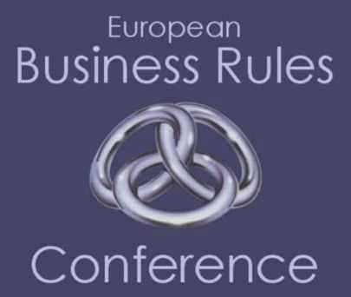




We have had help getting here…
Business Semantics Ltd

Slide 30






And we are not traveling alone
US NATIONAL
ARCHIVES
Already received compliance and privacy data on over 100 countries
from individuals, top tier banks and brokerage firms…currently in
discussions with additional:
    Global audit firms
    US and European Universities
    Global professional service firms
    Additional not-for-profit organizations
    Major law firms
    and dozens of the largest user organizations.

Slide 31
SOA and
Compliance

Slide 32
IT: The CIO Problem…
CIO’s cannot account for IT production management
  There is a disconnect between the objectives of business and the delivery of production management of supporting IT
  CIO’s want to manage their current production systems based on the delivery of Service Level Agreements
CIO’s are under pressure to cut costs and deliver value
  CIO’s want to virtualize, increase utility and automate to reduce operational costs.
  CIO’s want to reduce errors in operations through automation and so increase the guarantee of value to the business.

Slide 33
What are the requirement on IT?
  IT support to model and manage the controls and to ensure transparency.
  IT support to manage the flow, the creation of and the retention information/documents.
  IT support to verify that the controls meet the regulations (and so can be shown to be compliant through computational means)
Institute controls that enhance the transparency of communications, bringing to light any material deficiencies and highlighting key information that may be material to compliance
Control the way they process, distribute, retain, and access key financial information and supporting documentation in their day-to-day operations
Establish and maintain processes to ensure that the compliance program is followed, with periodic program review

Slide 34
What are the requirement on IT?
IT support to model and manage the controls and to ensure transparency.
IT support to manage the flow, the creation of and the retention information/documents.
IT support to verify that the controls meet the regulations (and so can be shown to be compliant through computational means)
  Declarative description of processes
  Outboard processes
  Outboard business rules (alternate paths)
  Outboard document creation (templating)
  Outboard processes
  Outboard document structure and make available salient concepts
  Automatic verification of processes and rules so that the execution can be shown to conform to the description

Slide 35
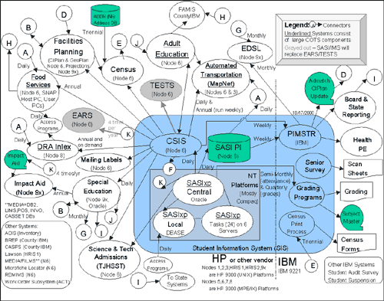
How do we do it today?
Proprietary sauce over a spaghetti mess.
No one solution. Nothing holistic.
A bunch of silos that seldom talk to each other.
Notes:
It’s a mess. There is no one solution. There is nothing holistic and we have a bunch of silos that seldom talk to each other.
A proprietary sauce over a spagehetti mess!

Slide 36
How do we do it today?
Document Management Systems
  Manage document production
  Often have own workflow and business rules
Workflow Systems
  Manage relationships and flow between processes and people.
Business Process Management Systems
  Manage relationships and flow between processes
Business Rules Engines
  Declarative ….

Slide 37
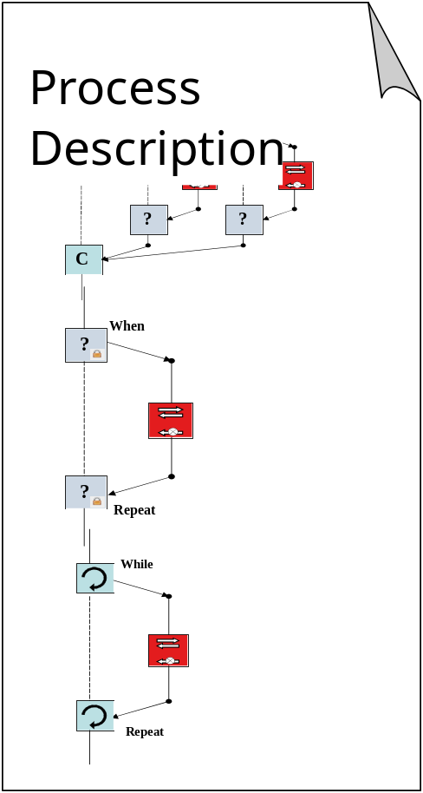
A Declarative Compliance Systems Architecture
Declarative
Compliance
Systems
Architecture
Business
Rules

Slide 38
The Business World is Deontic
Many business rules are about obligations
  Things that must be done
  ….But sometimes people don’t do them
This is what compliance is all about
  Rules can ensure compliance within IT Systems
  IT systems cannot carry out business actions – They can only inform/direct people in the business to act
Too much regulation for companies to handle alone
  Have to collaborate, e.g. Trade associations
  Have to buy guidance, e.g. Lawyers and Consultants
  Need to interchange on the Web and not in word documents

Slide 39
Summary
Applications and Architecture
  Isolate policy/rule processing to improve visibility and agility
  Adopt a Service Oriented Architecture as the underlying approach to component development and communications
Compliance
  Compliance requirements and technology is changing quickly
  Factor requirements to leverage commonalities
    Find common rules and manage them together
    Eliminate redundancies in data, processes, and systems
  Enterprise Compliance systems will transform from a defensive control system to a proactive component
  Automate Security & Auditing efforts
    Data, Controls, Procedures & Testing

Slide 40
Thank You!
Any questions?

Slide 41
The Securities Industry Example
Approx. 5,030 funds and 7,790 advisors currently registered controlling over $21 trillion of assets…
….and engaging in tens of millions of transactions each year…
…subject to hundreds of thousands of regulatory policies and guidelines

Slide 42
A Simple Model
shapes
Business Process
Organization Responsibility
shapes
is for
delivers
is for
Directive
Desired Result
Business Rule
realizes
Business Policy
Objective
is step towards
Goal
Is basis of
Regulation
Assessment
Is basis of
is judged in

